Slide 1
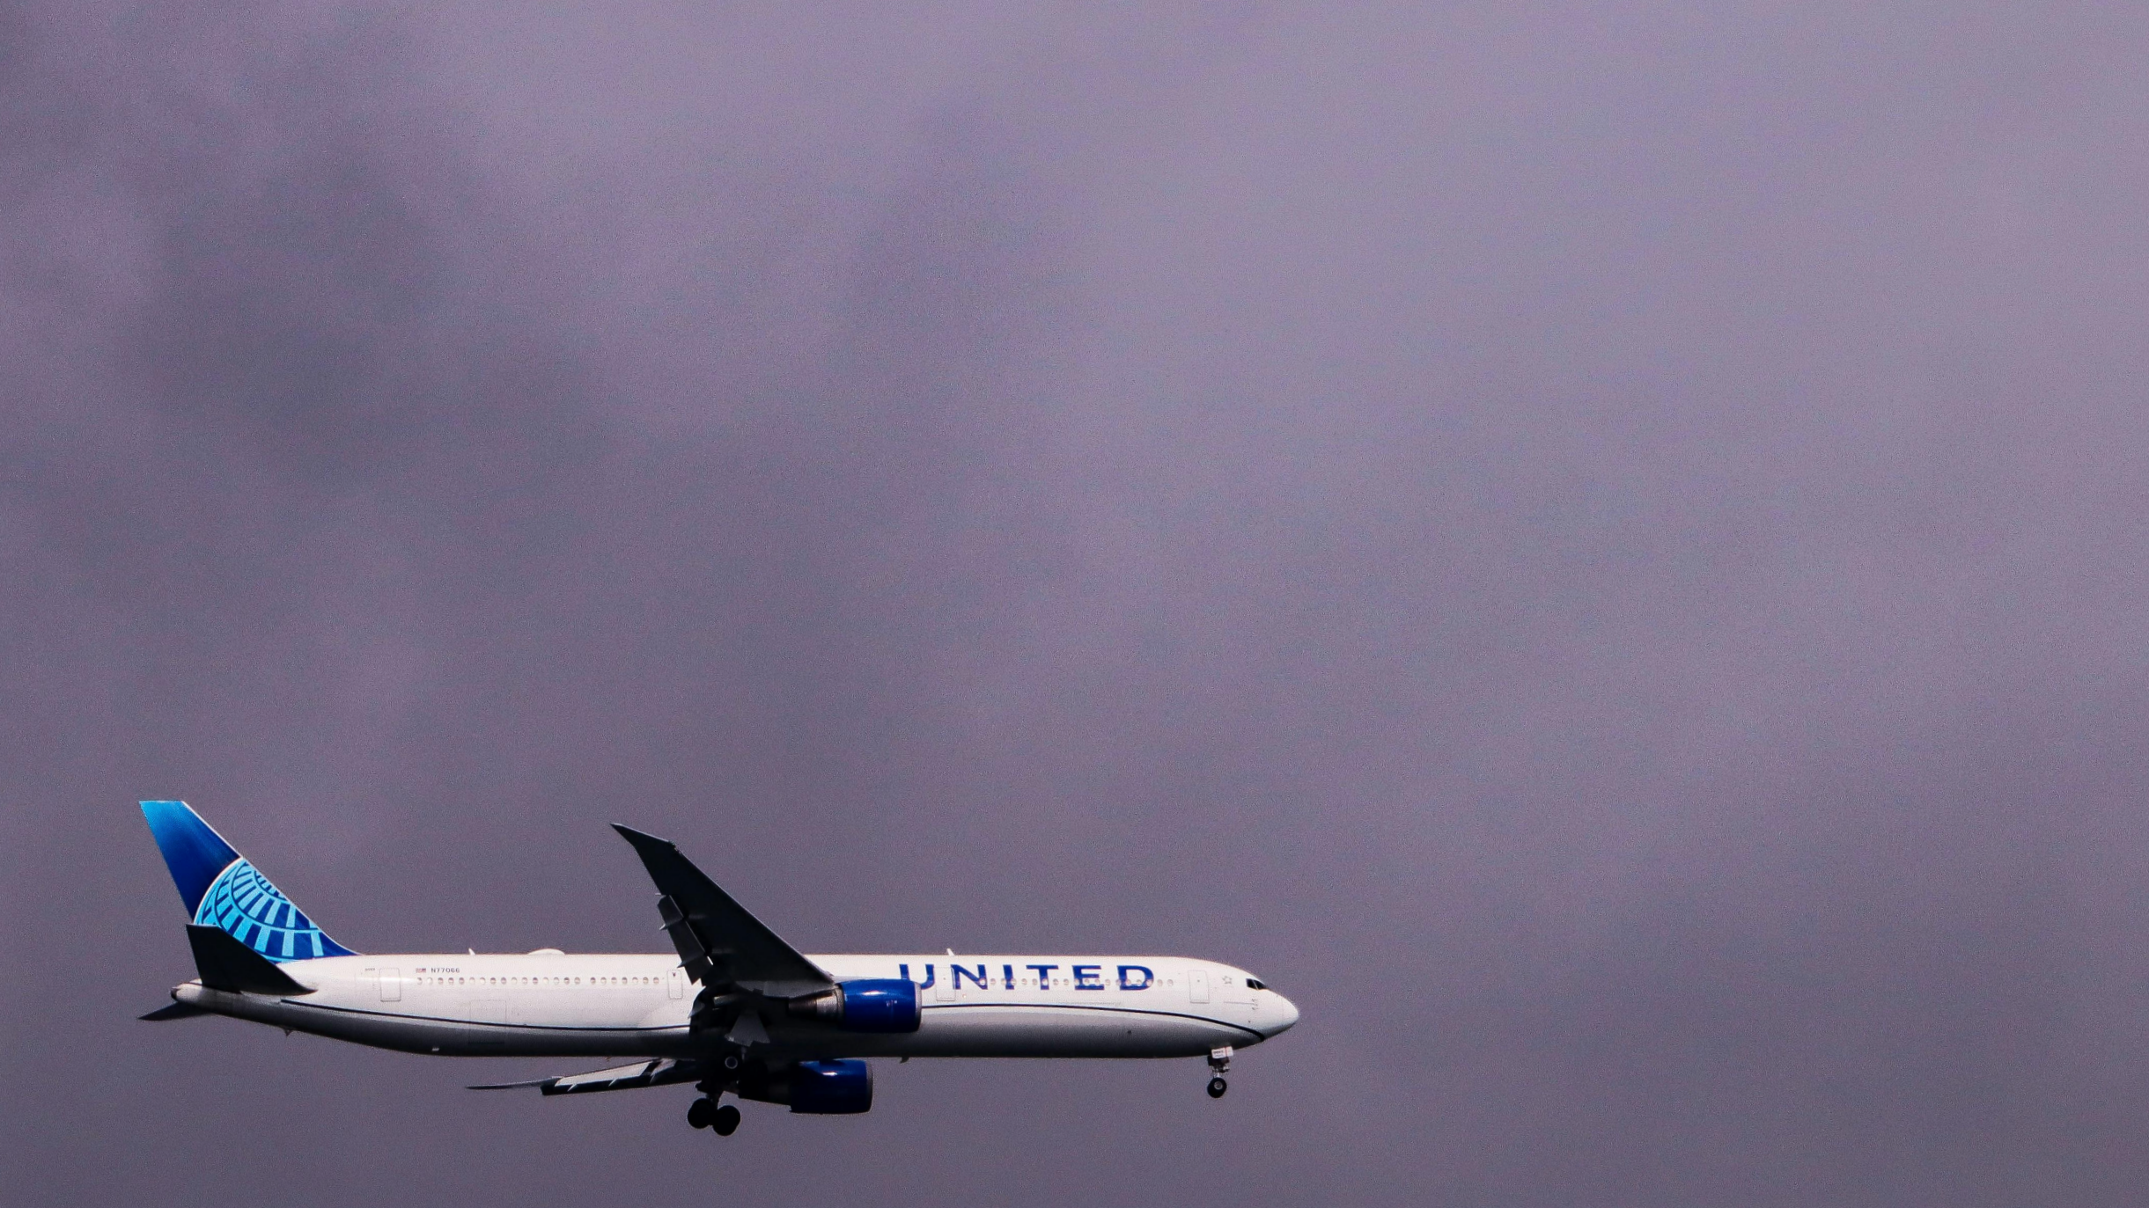

Team : Innov8torX_mini
A Data-Driven Framework for a Flight Difficulty Score

Slide 2
Table of Contents
The Business Challenge...........................................................................................................................3
Data & Our Hybrid Methodology..............................................................................................................4
Deliverable 1: Exploratory Data Analysis......................................... .......................................... 5-6
Deliverable 2: The Flight Difficulty Score Engine....................................................................... 7-8
Deliverable 3: Key Operational Insights....................................................................................... 10-11
The Business Impact: A $33M Opportunity................................................................................... 12
Actionable Recommendations & Deployment.............................................................................13
Conclusion..................................................................................................................................14
Thankyou page (Ending) ......................................................................................................................15
Appendix: Deep Dive Analysis...........................................................................................................16-24

Slide 3
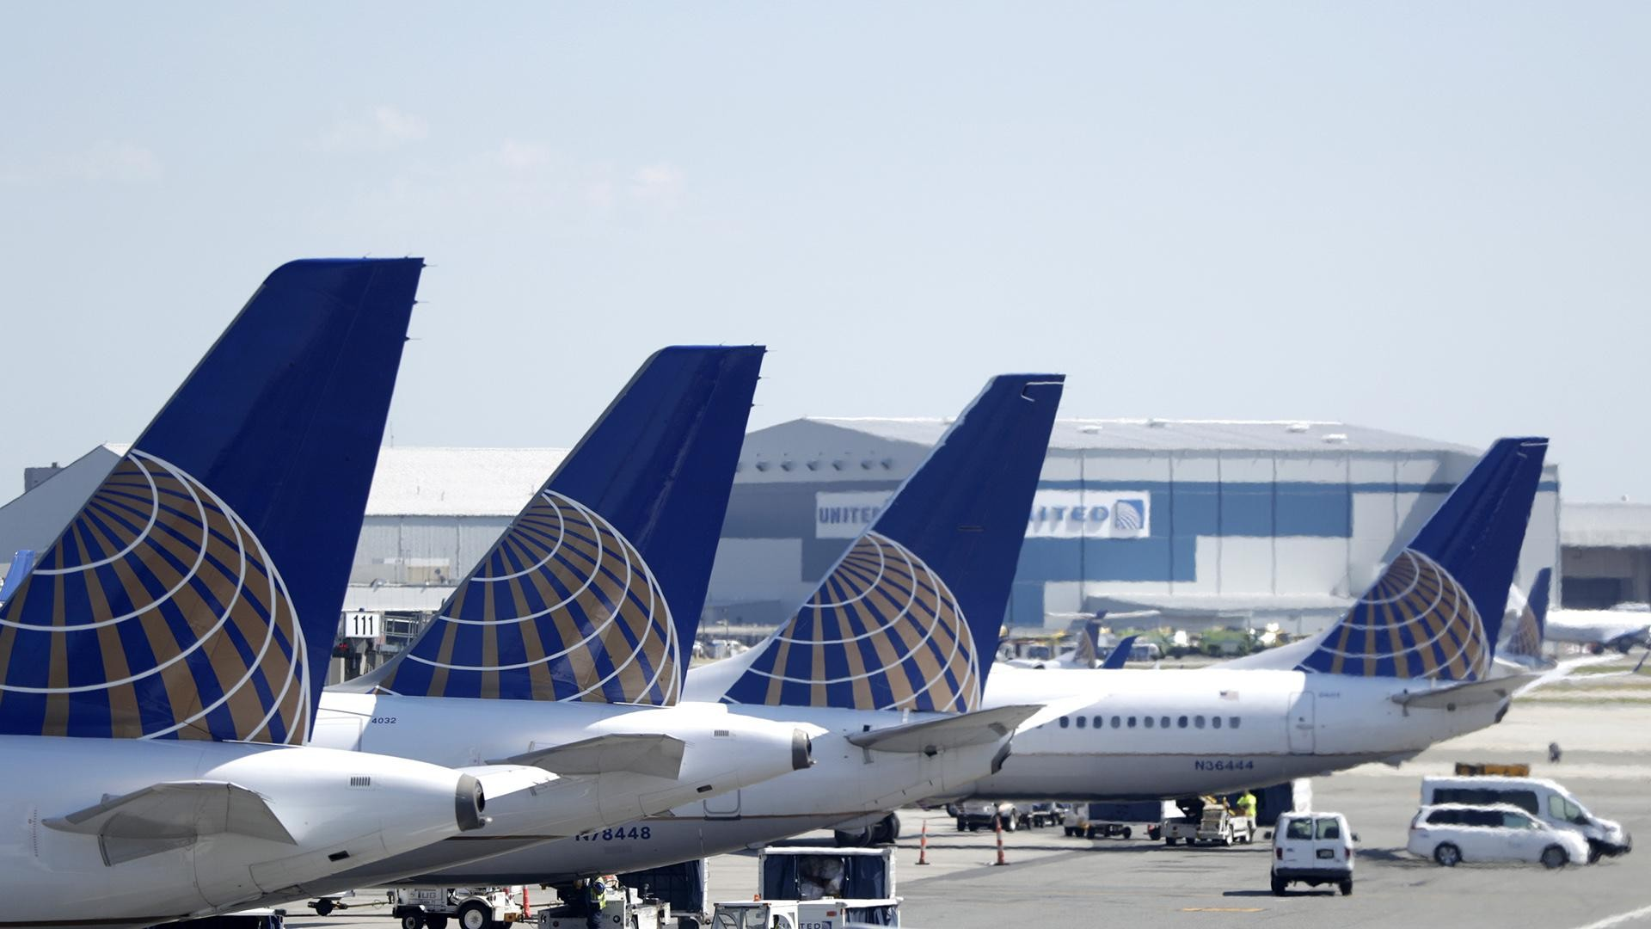
The Business Challenge: Moving from Reactive to Proactive Operations
Talking Points:
United's frontline teams are the backbone of the airline, responsible for the incredible feat of getting every flight out safely and on time. But they currently lack a systematic tool to anticipate which flights will need the most support.
Right now, identifying these 'difficult' flights relies on deep personal experience and local knowledge. This is invaluable, but it's also inconsistent from shift to shift and doesn't scale across the network.
This leads to reactive problem-solving when unforeseen issues with baggage, ground time, or passenger services arise, putting a strain on resources and on-time performance.
Our goal was to answer a simple question: How can we transform that invaluable human expertise into a consistent, data-driven tool that allows teams to plan proactively?
Relying on experience alone to manage complex flights is inconsistent, unscalable, and puts on-time performance at risk.

Slide 4
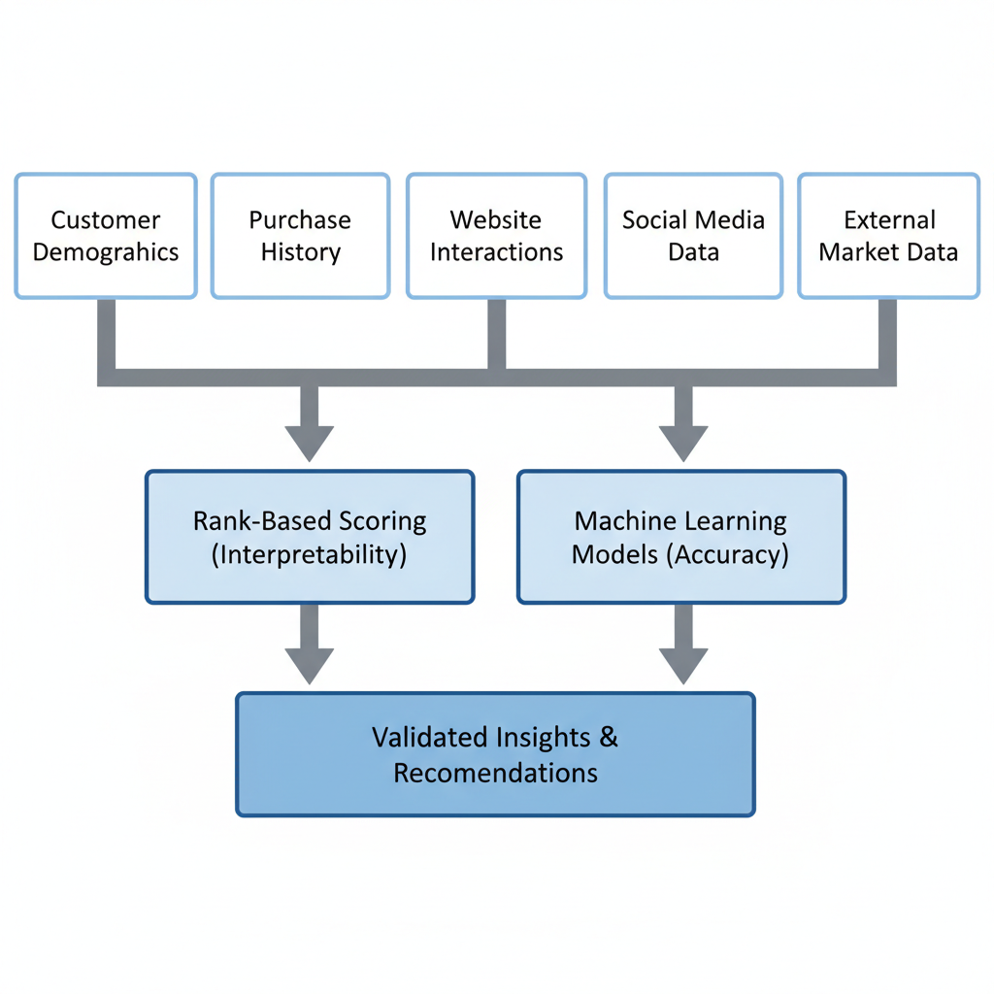
Data & Our Hybrid Methodology
Pg 3
Unified Data: We integrated 5 distinct datasets (Flights, PNR, Bags, Remarks, Airports) into a single, holistic view of every flight.
Hybrid Approach: We built a two-layer model to get the best of both worlds: operational simplicity and statistical power.
Layer 1 (The "How"): An Interpretable Rank-Based Score. This is a transparent model, easy for frontline teams to understand and trust.
Layer 2 (The "Proof"): Machine Learning Validation. We used Random Forest and Gradient Boosting models to validate our approach, achieving 95% cross-validation accuracy.

Slide 5
Deliverable 1: Exploratory Data Analysis What the Data Tells Us: ORD Operations Under Pressure
Pg 3
Our initial analysis of 8,099 flights reveals a system with little room for error, where delays are common and operational pressures are high.
Before building any models, we first had to understand the landscape. Our analysis of the provided data immediately revealed several key pressure points:
First, nearly half of all flights—49.6% to be exact—depart later than scheduled, with an average delay of over 21 minutes.
Second, a significant number of flights are set up for failure before they even land. We found 630 flights with a scheduled ground time below the required minimum.
Finally, special service requests have a major impact. Flights with a high number of SSRs are delayed by an average of 17.2 minutes more than other flights.

Slide 6
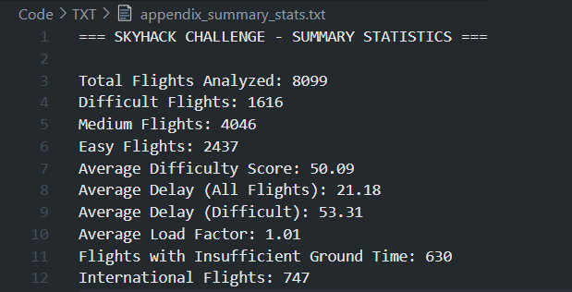
What the Data Tells Us: ORD Operations Under Pressure
Pg 3
Source: These metrics were calculated by our script enhanced_main.py during the initial data analysis phase.
Average Delay: 21.18 Minutes
% of Flights Delayed: 49.6%
Insufficient Ground Time: 630 Flights

Slide 7
Deliverable 2: The Flight Difficulty Score Engine
Pg 3
Our Solution: A Hybrid Scoring System
We built a two-layer solution: an interpretable Rank-Based Score for frontline teams, validated by powerful Machine Learning models for accuracy.
Talking Points:
Our primary model is a Rank-Based Scoring System. It's transparent and easy for operations teams to understand. It classified 1,616 flights as 'Difficult'.
But we didn't stop there. To ensure accuracy, we validated this approach with industry-standard Machine Learning models, specifically Random Forest and Gradient Boosting.
To solve this, we developed a sophisticated scoring engine. First, we engineered 39 distinct features from the raw data.
Raw Data -> 39 Engineered Features -> Rank-Based Score -> ML Validation

Slide 8
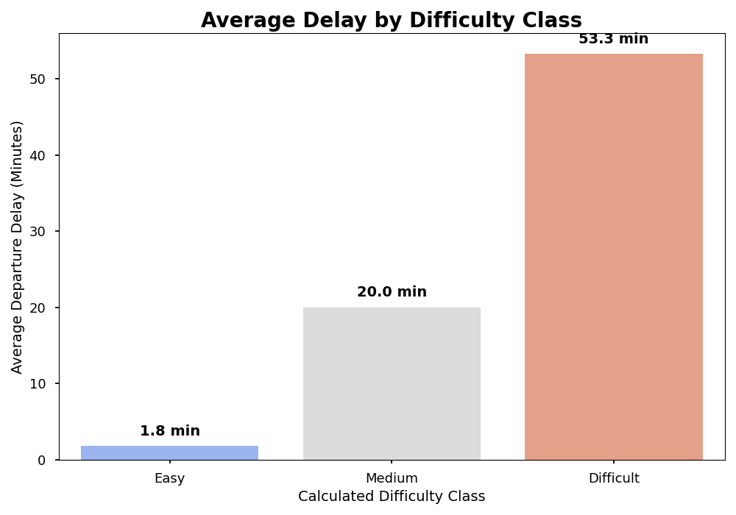
The "Proof": Three Layers of Validation
Pg 3
We Didn't Just Build a Model, We Proved It Works
Our system is rigorously validated with a 29x delay separation, 95% cross-validation accuracy, and successful next-week predictions.
delay_validation_chart.png
Source: All validation metrics were generated by enhanced_main.py and are available in the console output and ml_validation_results.csv.

Slide 9
The "Proof": Three Layers of Validation
Pg 3
We Didn't Just Build a Model, We Proved It Works
A model is only useful if it's reliable, so we validated our system three different ways:
First, our Rank-Based score shows a massive 29x delay separation. 'Easy' flights are delayed by only 1.8 minutes on average, while our 'Difficult' flights are delayed by 53.3 minutes.
Second, we trained our Gradient Boosting model on the first week of data and used it to predict the second week. It achieved an impressive 92% accuracy on unseen data.
Finally, 5-fold cross-validation confirms the model's stability, with the Gradient Boosting model achieving a 94.9% accuracy.
Source: All validation metrics were generated by enhanced_main.py and are available in the console output and ml_validation_results.csv.

Slide 10
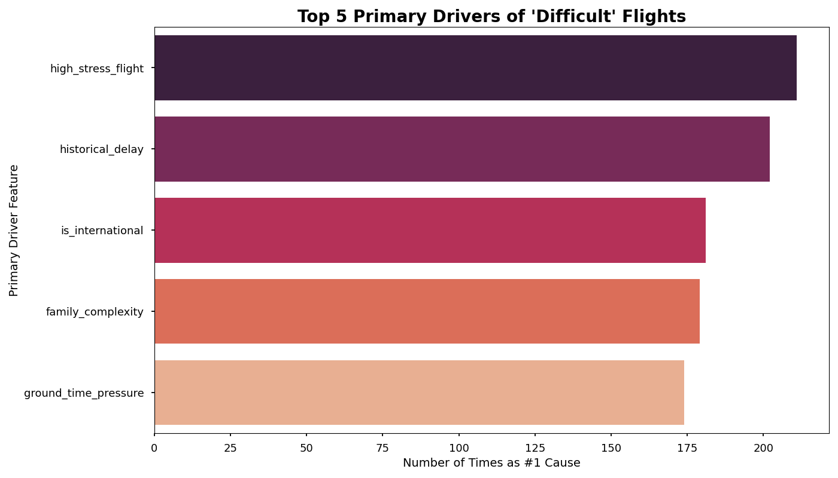
Deliverable 3: Uncovering the "Why"
Pg 3
Insight: What Truly Drives Flight Difficulty?
Our models consistently identified that time pressure and historical performance are the two most important predictors of difficulty.
By analyzing our model, we can pinpoint the features that matter most.
As you can see, Ground Time Pressure and Historical Delay are, by far, the most influential factors. This tells us that a flight's past performance and its scheduled turnaround time are the best indicators of its future difficulty.
This insight allows us to focus our recommendations where they will have the greatest impact.
Source: Feature importances were calculated by the Random Forest and Gradient Boosting models in enhanced_main.py.

Slide 11
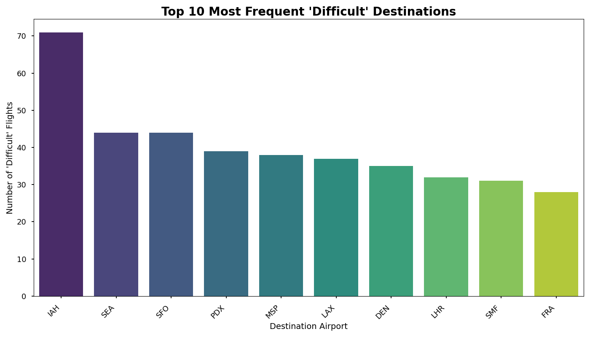
Deliverable 3: Pinpointing the "Where"
Pg 3
Insight: Top 5 Most Difficult Destinations from ORD
The model flags specific international and high-volume routes that consistently demand the most resources.
Talking Points:
Our score allows us to move from general feelings to a specific, data-driven list of the most operationally challenging routes.
Flights to international hubs like Brussels (BRU), Athens (ATH), and Frankfurt (FRA) consistently rank as the most difficult to manage, requiring specialized attention.
Source: Generated by additional_analysis.py by filtering for flights classified as 'Difficult' and aggregating by destination.

Slide 12
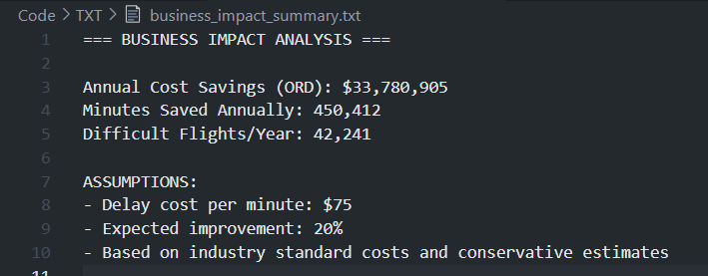
The Business Impact: A $33M Annual Opportunity
Pg 3
From Minutes to Millions: The Financial Impact
Based on conservative estimates, proactive staffing enabled by our model could save United over $33 million annually at ORD alone.
Talking Points:
Let me walk you through our ROI calculation transparently.
The industry standard cost of a delay is $75 per minute. Our model identified over 42,000 'Difficult' flights annually at ORD, each averaging a 53.3-minute delay.
If proactive staffing reduces that delay by a conservative 20%—that's just 10.7 minutes per flight—the annual savings are over $33.7 million.
Even at a 10% improvement, the savings are nearly $17 million.
Source: All figures are from the business_impact_summary.txt file generated by our analysis.

Slide 13
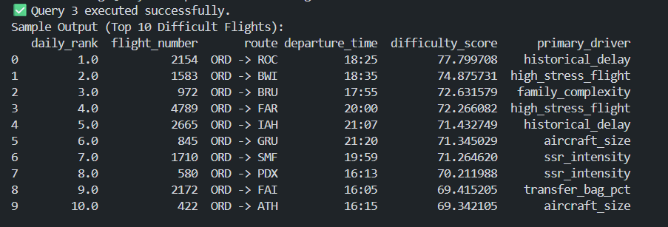
Actionable Recommendations & Deployment
Pg 3
From Insights to Action: Ready for Deployment Monday
This isn't just a theory; we've written the production-ready SQL to integrate these insights into daily operations immediately.
Source: Generated by running python test_all_sql.py in Code folder
Talking Points:
"Our analysis leads to specific, high-impact recommendations like prioritizing baggage handlers for transfer-heavy flights and creating specialized procedures for the consistently difficult BRU and ATH routes."
"Crucially, this is ready to deploy. We've written 7 production SQL queries that can be integrated into United's existing systems to generate a 'Top 10 Difficult Flights' report for station managers every morning at 5 AM."

Slide 14
Conclusion
Pg 3
The Complete Solution for Proactive Operations
We are delivering a complete, validated, and production-ready system that transforms data into significant financial and operational improvements.
A Hybrid Model (Interpretable Ranks + ML Accuracy)
Three Layers of Validation (Separation + Temporal + CV)
A $33M Justified Business Case (Transparent ROI)
A Ready-to-Deploy Solution (Production SQL Queries)
Source: Generated by running python test_all_sql.py in Code folder

Slide 15
Thank You
Team Name: Innov8torX_mini

Slide 16
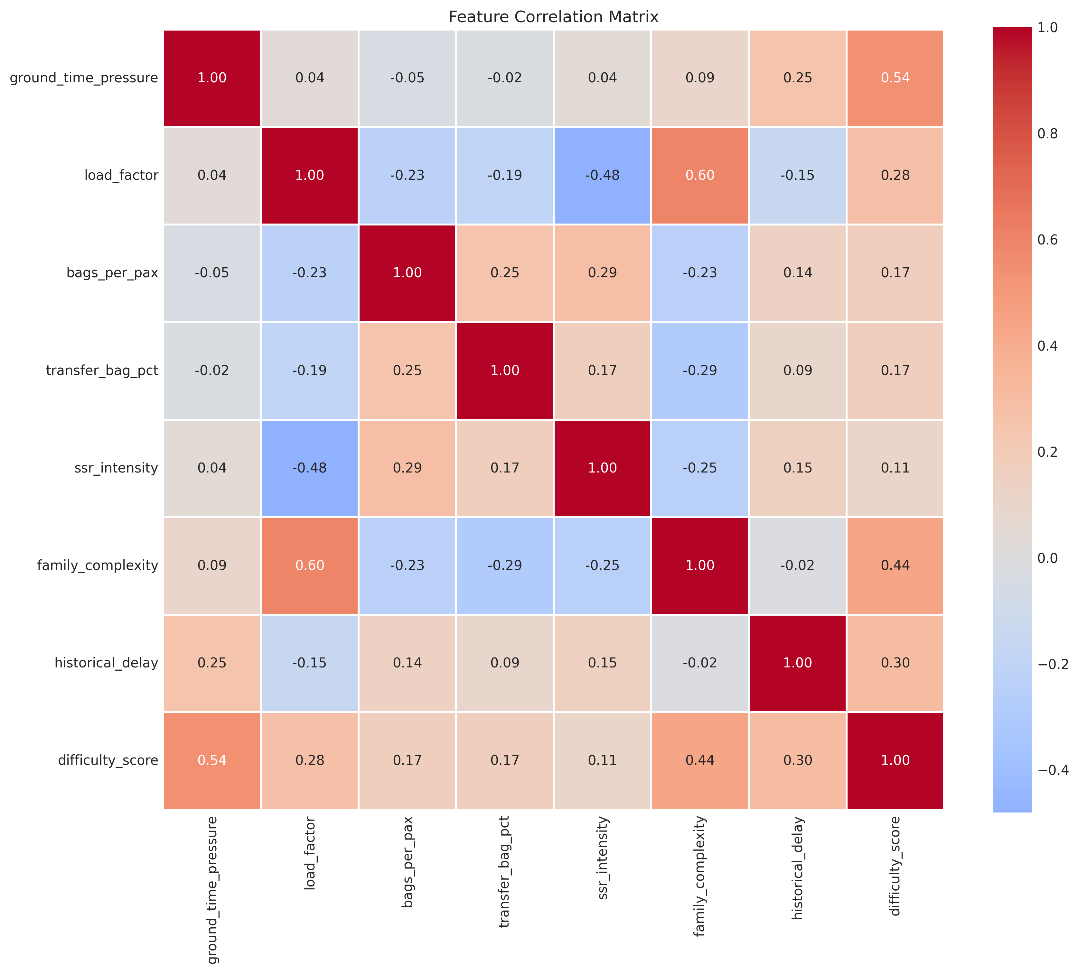
Appendix A: Deeper Dive into Feature Relationships
Pg 3
Quantifies linear relationships between all engineered features.
Validates that features like historical_delay strongly correlate with the final score.
Confirms low multicollinearity, meaning features provide unique information.
Source: Generated by appendix_generator.py from final_flight_data.csv. Filename: appendix_chart_2_correlation.png.

Slide 17
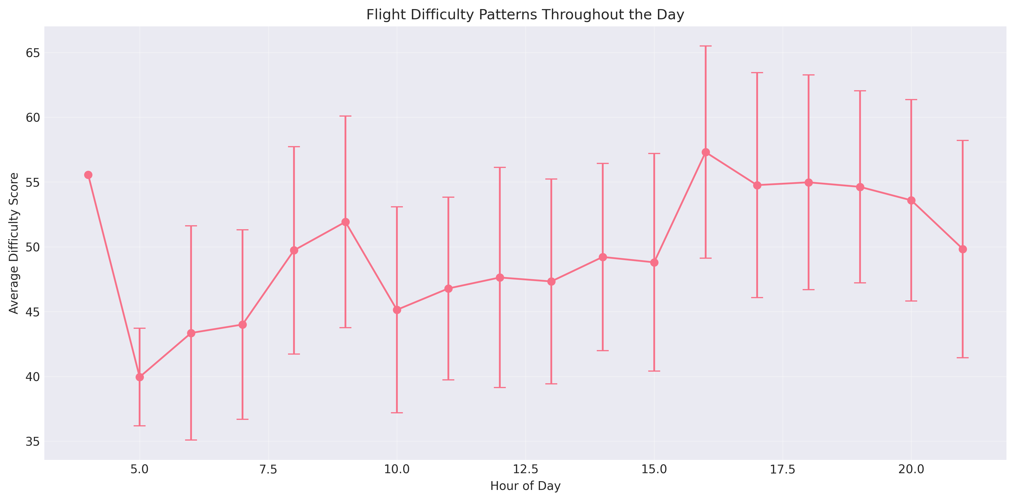
Appendix B: Daily Operational Tempo
Pg 3
Visualizes the airport's daily operational tempo.
Clearly shows two stress peaks: the morning rush (6-9 AM) and a larger evening rush (4-8 PM).
Provides real-world validation that our score captures the airport's natural rhythm.
Our difficulty score accurately captures the real-world operational rhythm of the airport, peaking during the morning and evening rush hours.
Source: Generated by appendix_generator.py from final_flight_data.csv. Filename: appendix_chart_3_hourly_pattern.png. Inside Code/Charts/

Slide 18
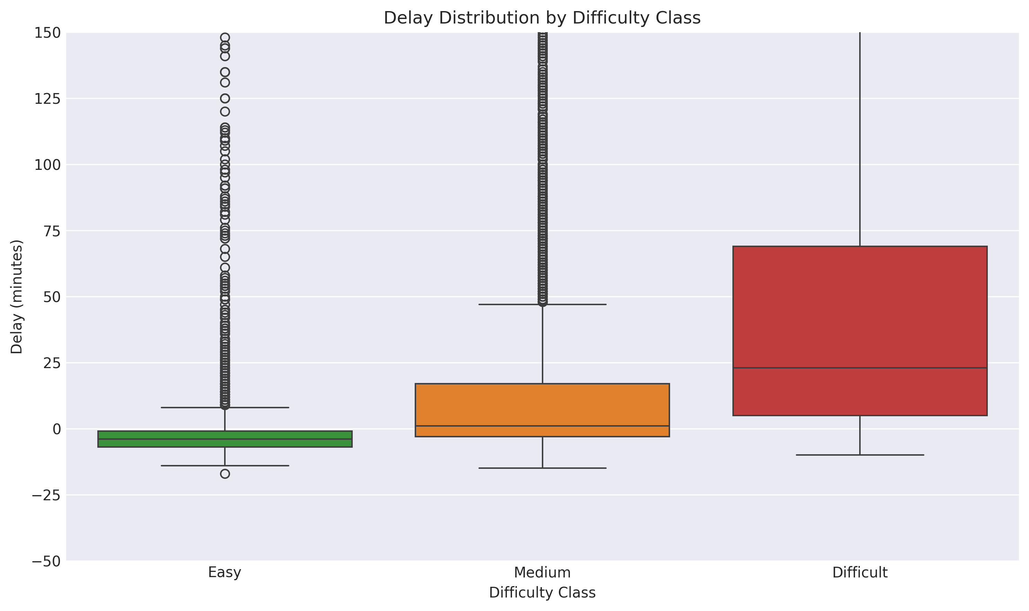
Appendix C: Statistical Proof of Score's Effectiveness
Pg 3
Shows the full statistical distribution of delays for each class, not just the average.
Median delay sharply increases from 'Easy' to 'Difficult'.
The larger box for 'Difficult' flights proves higher unpredictability and variance in delays
Source: Generated by appendix_generator.py from final_flight_data.csv. Filename: appendix_chart_7_delay_boxplot.png.

Slide 19
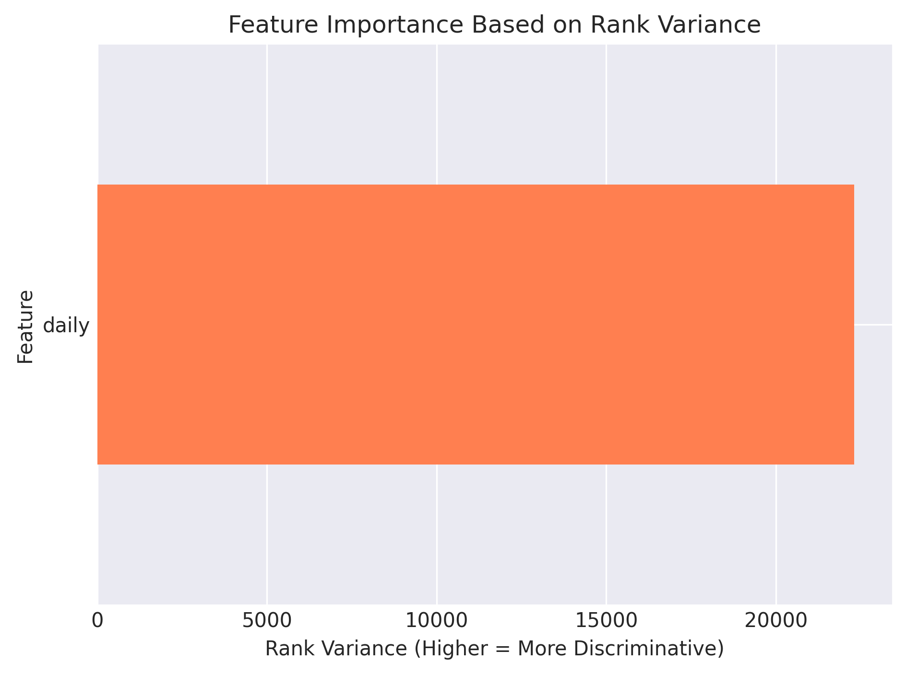
Appendix D: Feature Importance
Pg 3
Ranks features by their predictive power in our Machine Learning models.
Confirms that ground_time_pressure and historical_delay are the top two drivers of difficulty.
Aligns ML findings with our primary rank-based model, increasing confidence.
This chart confirms that time pressure and historical performance are the most influential factors in our model.
Source: Calculated by enhanced_ml_analyzer.py and visualized by appendix_generator.py. Filename: appendix_chart_8_feature_importance.png.

Slide 20
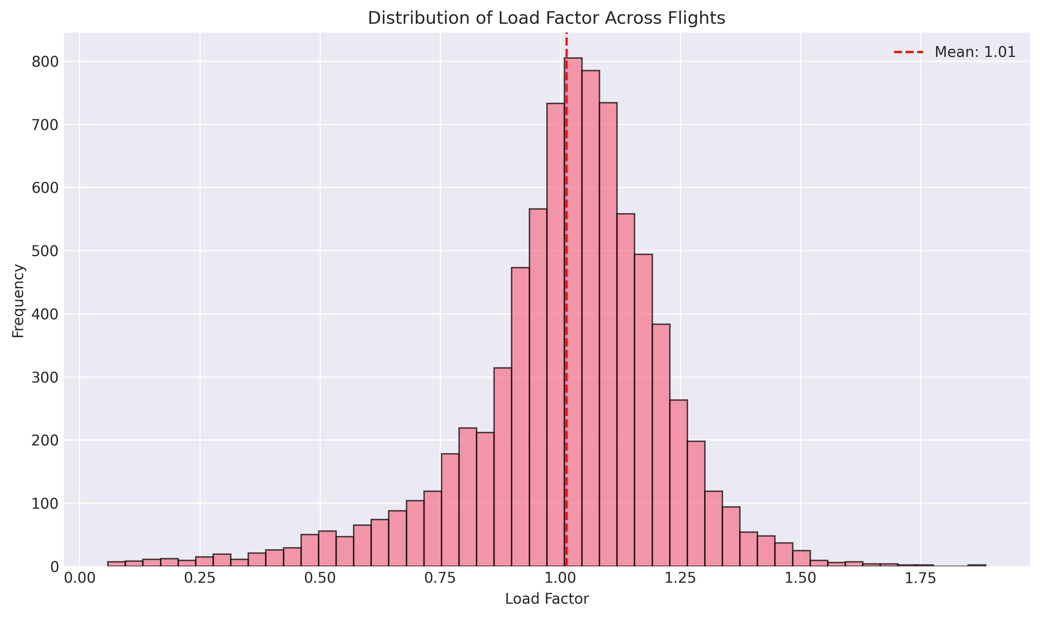
Appendix E: Understanding Passenger Load Pressure
Pg 3
Visualizes passenger load across all 8,099 flights.
Distribution is heavily skewed left, with a strong peak near 100% capacity.
Confirms that high passenger load is a persistent, system-wide pressure point.
The data shows that the vast majority of flights operate at or near full capacity, meaning there is very little slack in the system for passenger-related issues.
Source: Generated by appendix_generator.py from final_flight_data.csv. Filename: appendix_chart_1_load_factor.png.

Slide 21
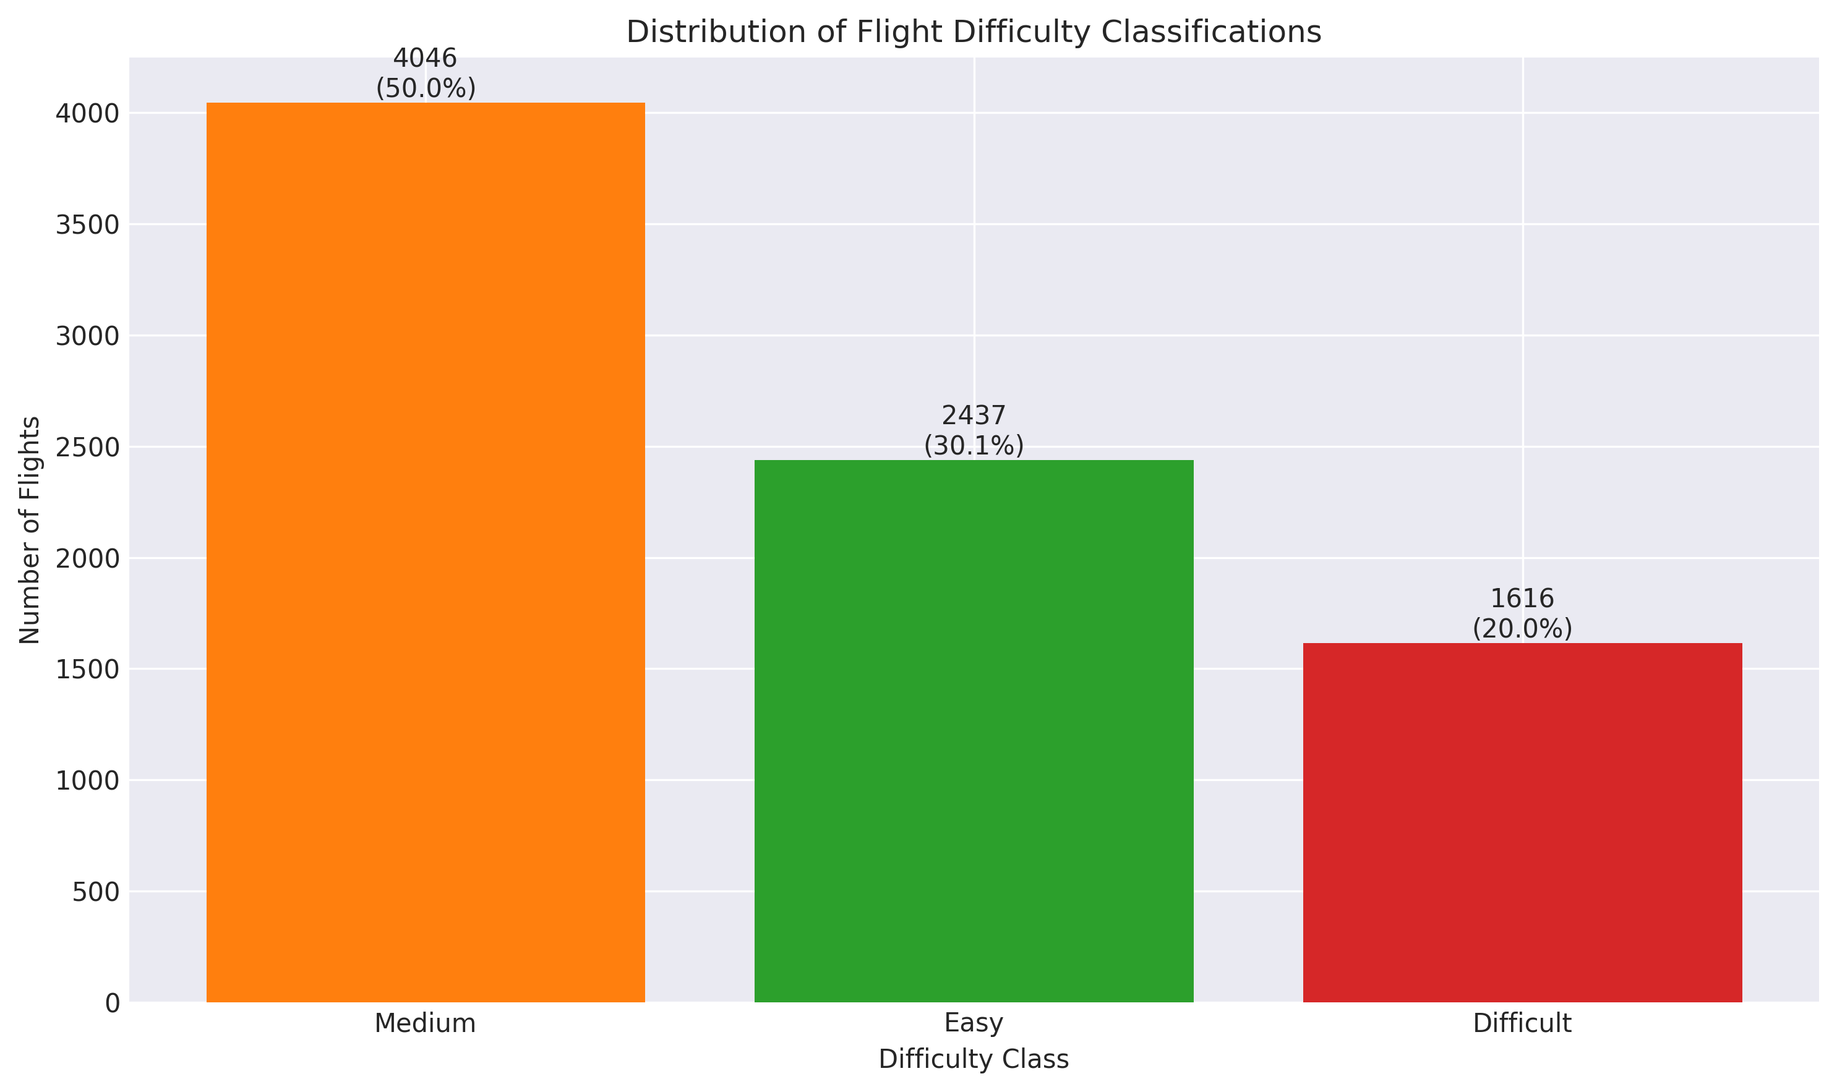
Appendix F: Classification of the Flight Population
Pg 3
Shows the final segmentation of all flights into our three difficulty classes.
Model isolates a manageable 20% of flights (1,616 total) as 'Difficult’.
Demonstrates the solution is practical and avoids "alert fatigue" by focusing on the critical few.
Our model classifies a manageable 20% of flights as 'Difficult', allowing for a focused and targeted operational response.
Source: Generated by appendix_generator.py from final_flight_data.csv. Filename: appendix_chart_4_difficulty_distribution.png.

Slide 22
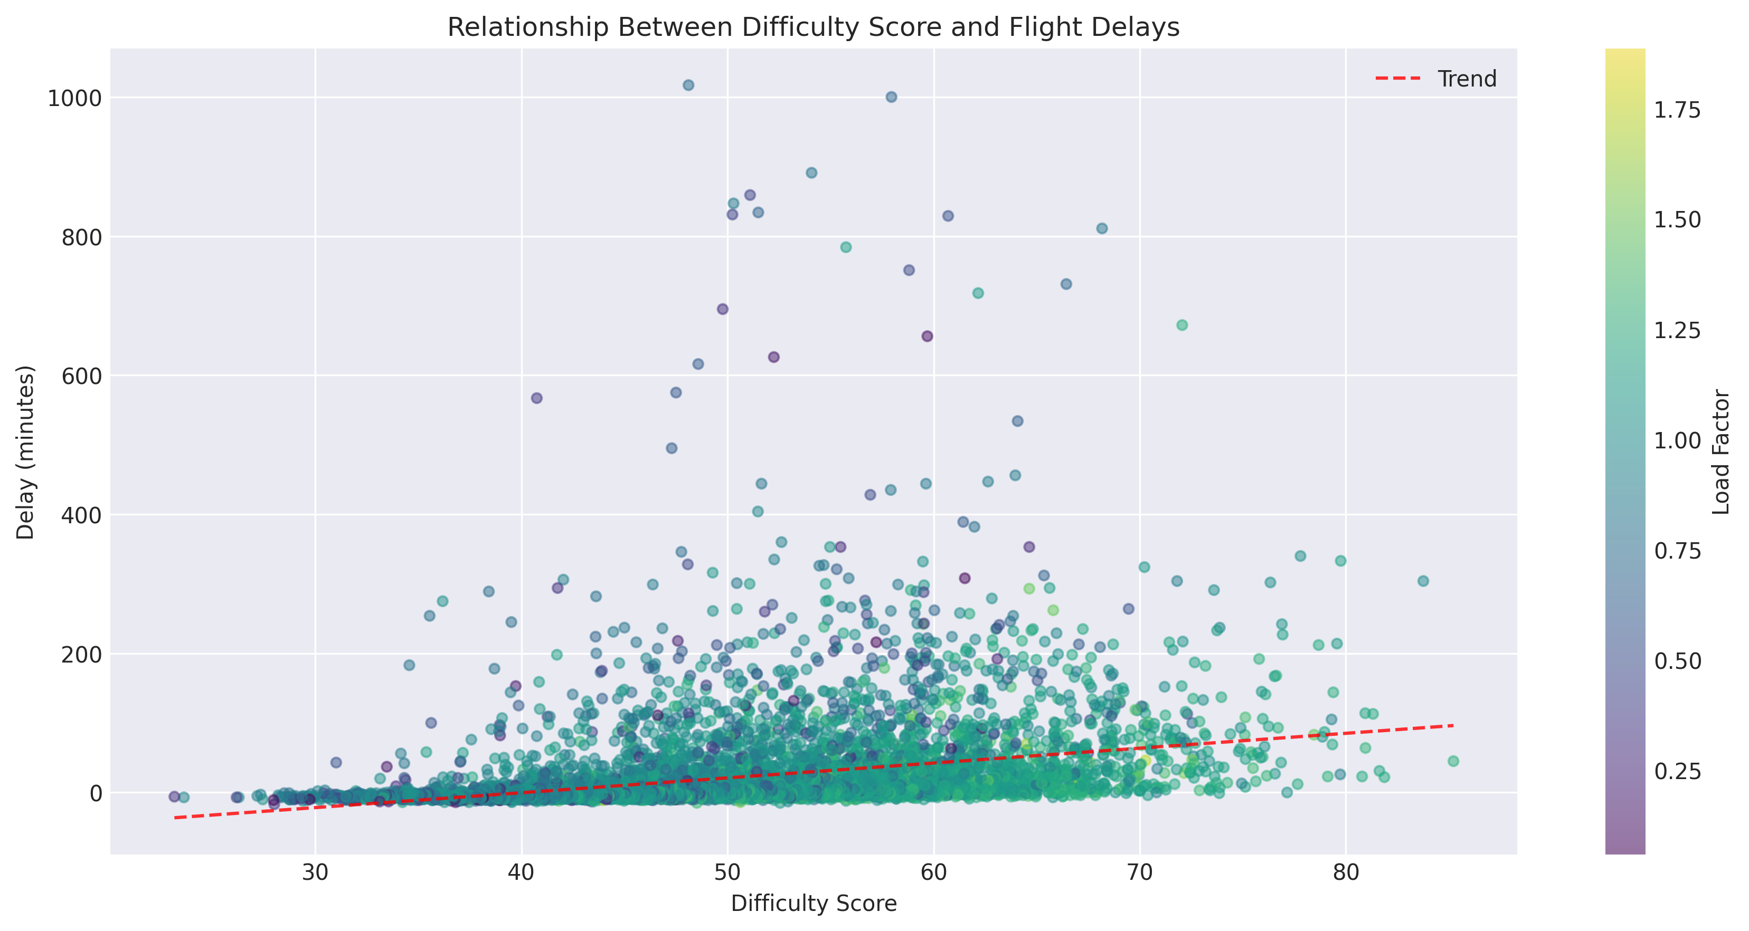
Appendix G: Direct Correlation Between Score and Delay
Pg 3
This scatter plot visualizes the relationship between our calculated difficulty_score and the actual delay_minutes for every single flight.
The upward trend, highlighted by the red trendline, provides clear visual proof that as our difficulty score increases, the real-world delay tends to increase as well.
The coloring by load_factor adds another dimension, showing that high-load flights (yellow dots) are present across all difficulty levels.
Source: Generated by appendix_generator.py from final_flight_data.csv. Filename: appendix_chart_5_delay_vs_difficulty.png.

Slide 23
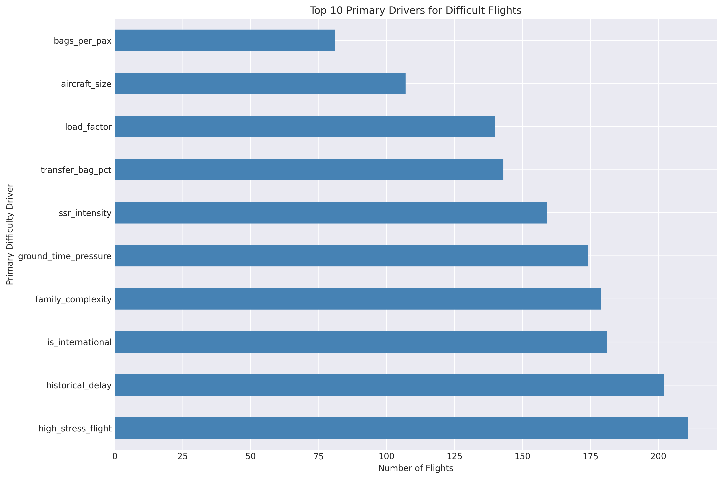
Appendix H: Top 10 Root Causes for 'Difficult' Flights
Pg 3
This bar chart provides a detailed breakdown of the most frequent "Primary Driver" for the 1,616 flights our model classified as 'Difficult'.
It offers more detail than the chart in the main presentation, breaking down the top 10 root causes.
This provides granular evidence for our recommendations, showing exactly which problems (like high_stress_flight and historical_delay) are the most common and need to be addressed
Source: Generated by appendix_generator.py from final_flight_data.csv. Filename: appendix_chart_6_primary_drivers.png.

Slide 24

Just like United, our ideas are ready to soar – thanks for flying with us on this journey!

